Slide 1
PriFi
Low-Latency Wireless Anonymity and Provable Protection from Communication Tracking, Fingerprinting, and Traffic Analysis
Ludovic Barman¹, Mahdi Zamani², Italo Dacosta¹, Ennan Zhai³, Joan Feigenbaum³, Bryan Ford¹, Jean-Pierre Hubaux¹
¹EPFL, ²Visa, ³Yale
Notes:
TEXT: This is a presentation about PriFi.
Prifi provides Low-Latency Wireless Anonymity
and Provable Protection from Communication Tracking, Fingerprinting, and Traffic Analysis
<number>

Slide 2









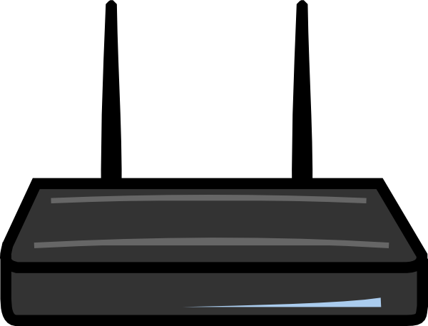

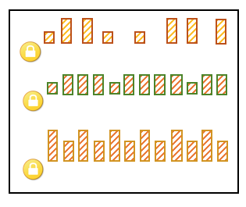



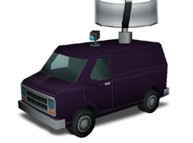

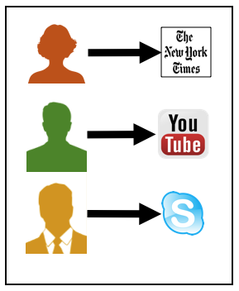
Alice reading the news
Internet
Bob watching a video
Charlie in videoconference call
Eavesdropper
!
Notes:
In a typical organization, users communicate with the Internet through their wireless infrastructure. Their traffic is encrypted, but often have unique traffic patterns.
An eavesdropper observes the different communication patterns of each user. This is commonly-known as a parking lot attack.
Even if the traffic encrypted, the eavesdropper can fingerprint the traffic pattern to infer which application the user is running, or the identity of the user.
He can potentially track the users as they move around.
Finally, he may even learn what the user is doing in a specific application, such as when Alice sends a specific document to Bob.
<number>

Slide 3

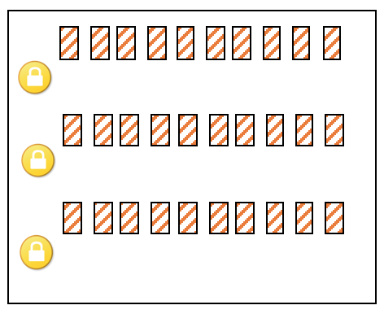

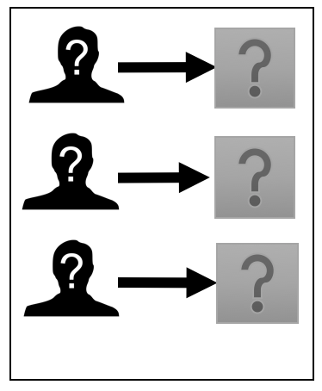
PriFi
Alice
PriFi
Internet
Bob
PriFi
PriFi
indistinguishable
Charlie
PriFi
Eavesdropper
?
Notes:
Now, let’s examine the situation with PriFi.
PriFi users are anonymous.
More importantly, PriFi uses strong cryptographic techniques to hide their communication patterns.
The eavesdropper trying to fingerprint the traffic is now unable to perform the attack, as he realizes that the communications are indistinguishable.
<number>

Slide 4

PriFi Architecture
Internet
VPN
VPN
PriFi Remote Clients
PriFi Access Point
PriFi Clients
PriFi Anonymity Cloud
Company/Organization
Notes:
PriFi’s architecture is comprised of a PriFi Access Point (a drop-in upgrade to existing wireless networks), and special software run by the users.
PriFi also supports roaming users connected through VPN, and provides them with the same level of protection.
All users can access the Internet in a transparent manner through PriFi.
<number>

Slide 5
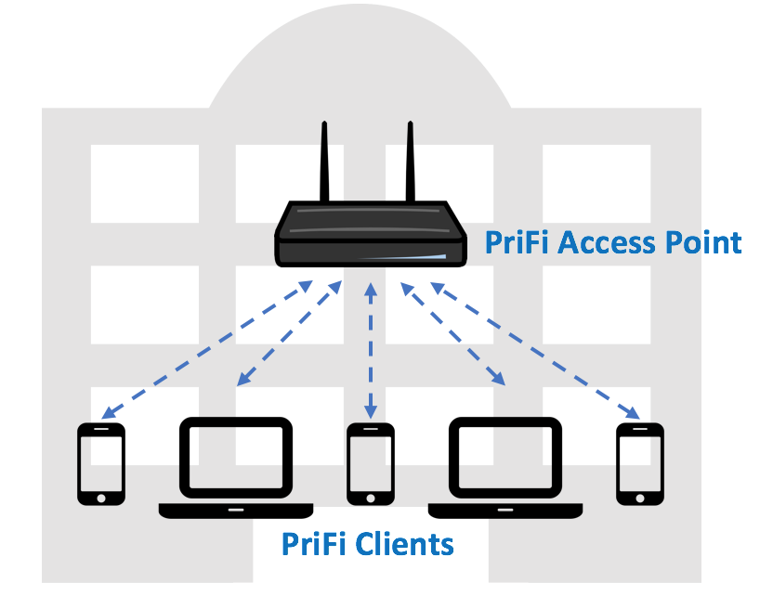
PriFi Scalability
VPN
Internet
VPN
VPN
PriFi Remote Clients
Notes:
Finally, PriFi can scale to thousands of users, and can be deployed across multiples building and institutions.
<number>

Slide 6
For more information visit: www.prifi.net
DHS Grant FA8750-16-2-0034
Notes:
For more info…
<number>

Slide 7
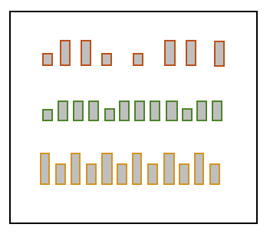

Alice
Internet
Bob
Charlie
Eavesdropper
!
Notes:
Problem/motivation
Adversary observes the different communication patterns of each device/user (parking lot attack)
Even if the traffic is encrypted, the adversary can infer details about the different type of application/protocols used due to their unique traffic patterns. (fingerprintability)
Using traffic analysis and machine learning techniques, an adversary can infer even more specific details such as the exact services/places users are accessing
IP and MAC addresses can be used to identify the targeted users and link all their communications. They are typically fixed/static. (traceability)
Parking lot attacks is one of the reasons why many organizations ban wireless communications
<number>

Slide 9
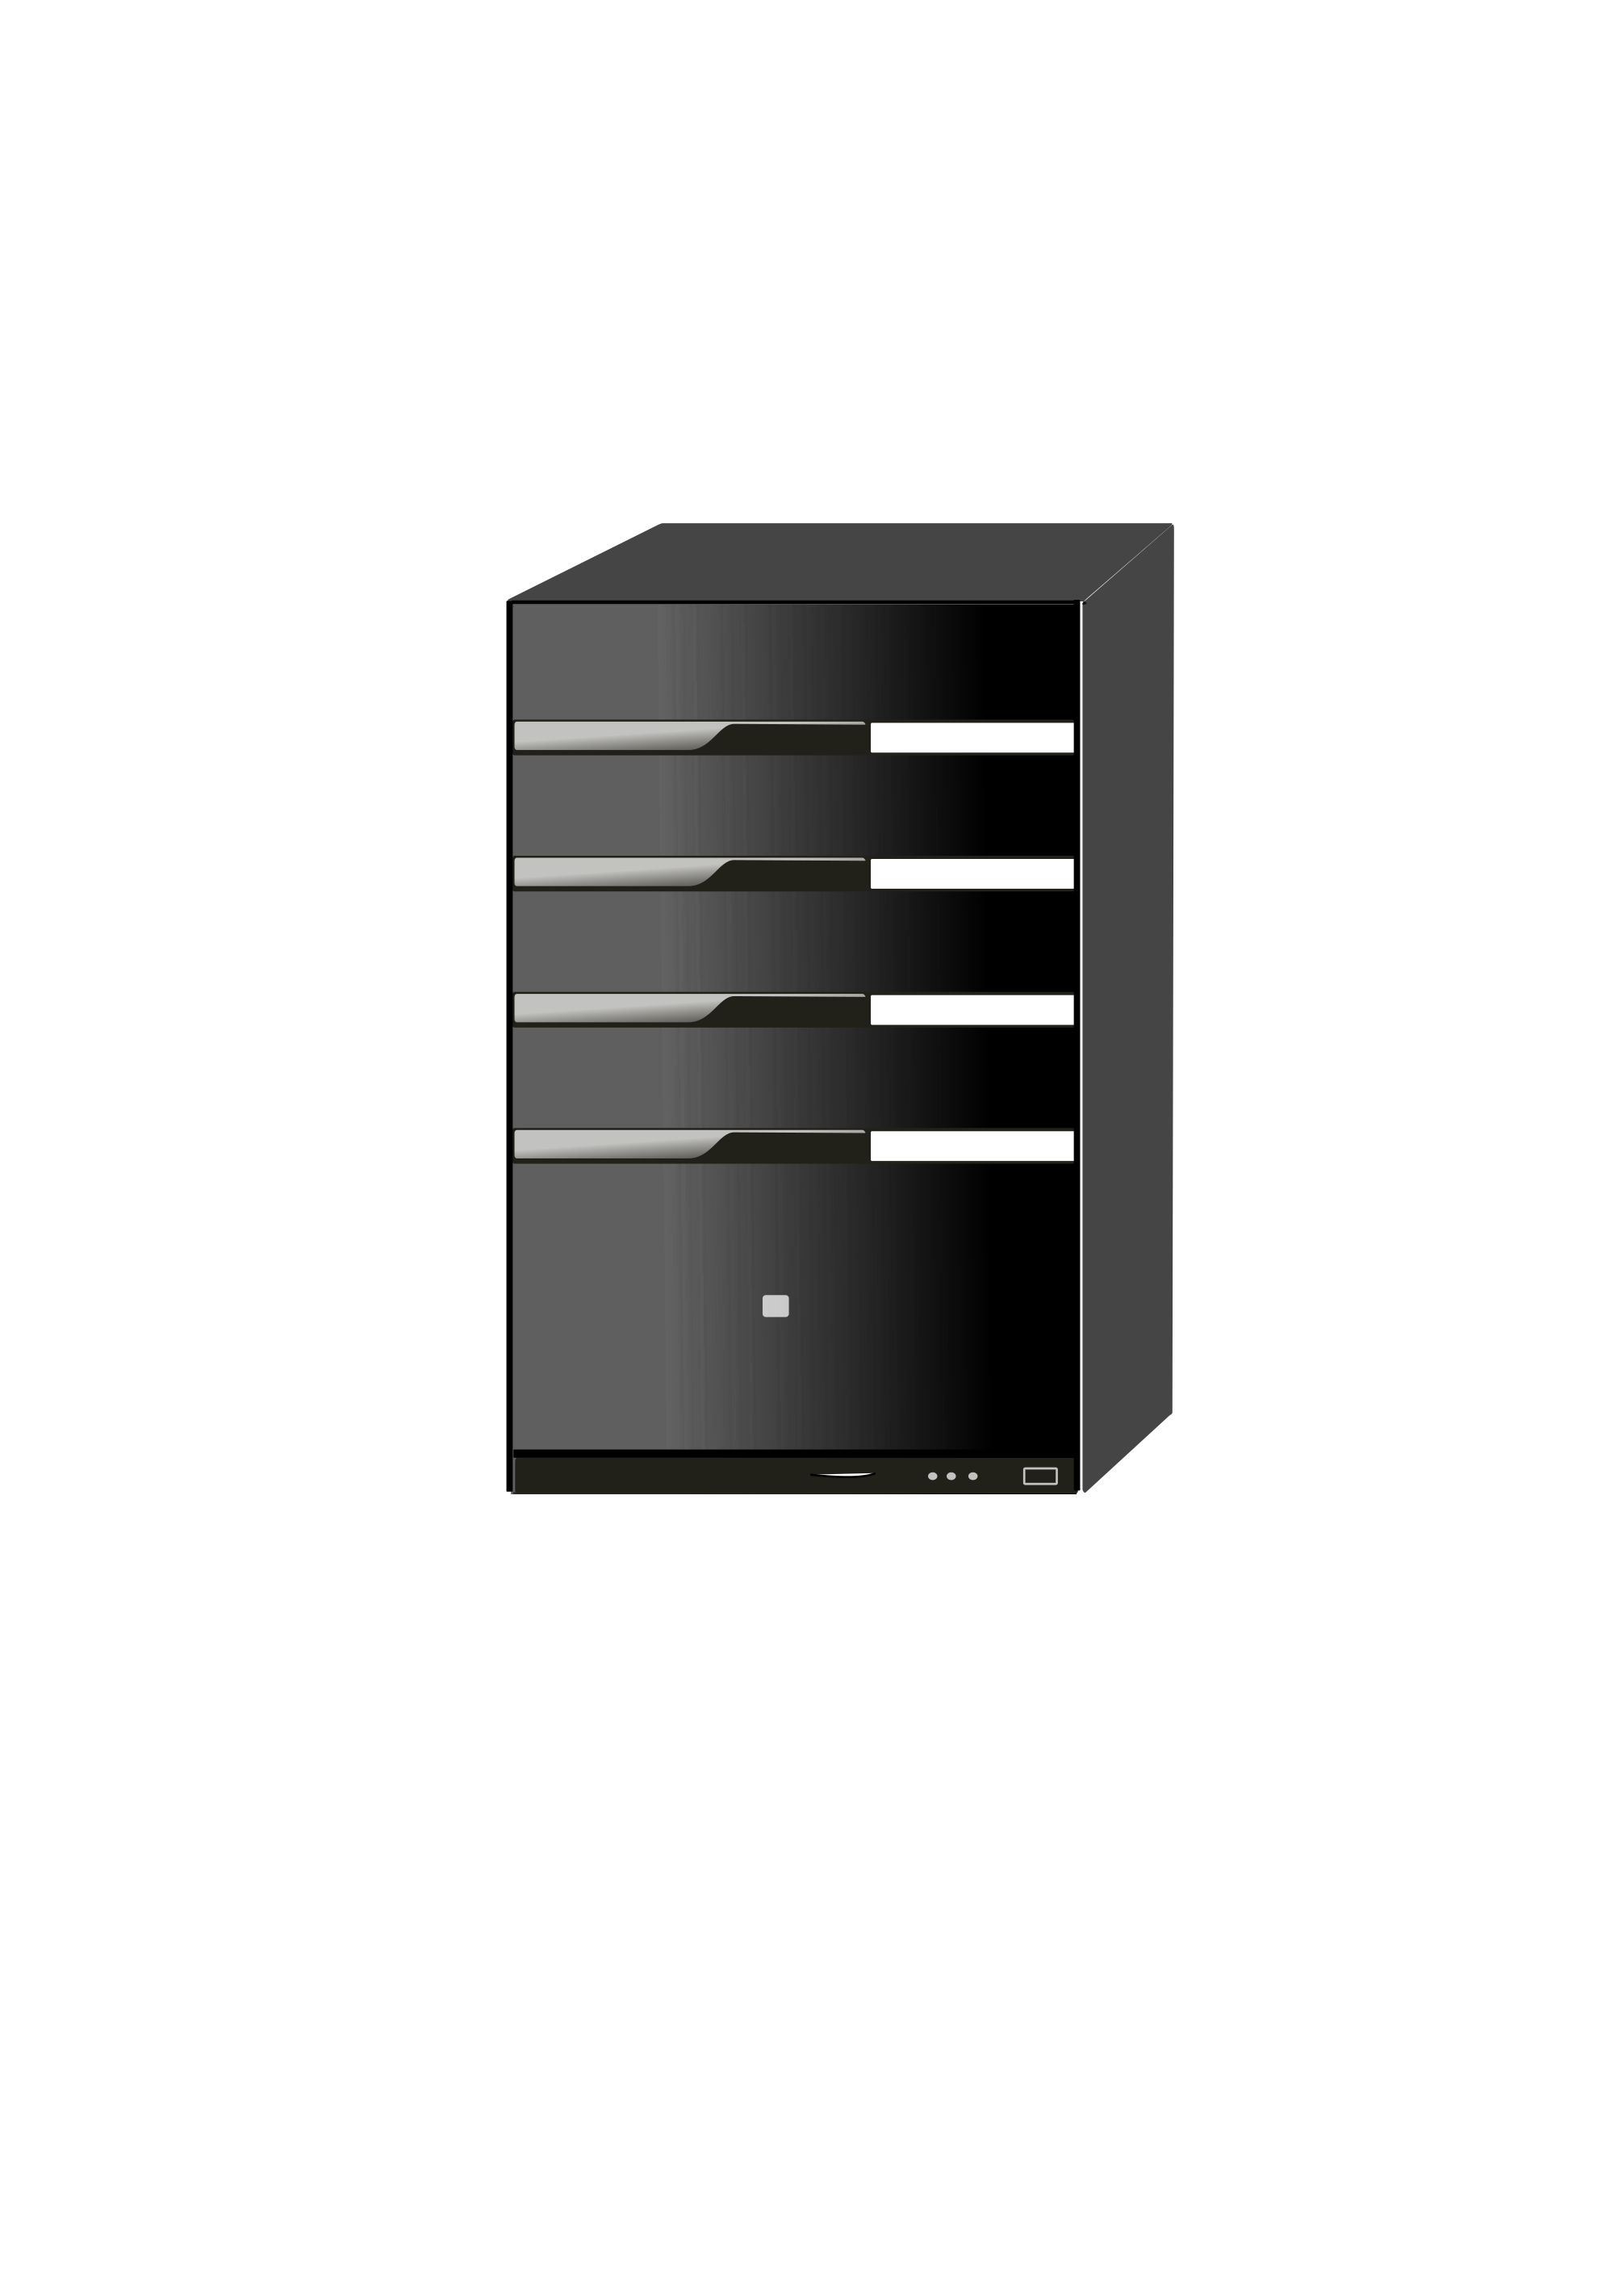

PriFi
Alice
PriFi
Internet
Bob
PriFi
PriFi
PriFi
PriFi
Charlie
PriFi
PriFi
Adversary
Notes:
Problem/motivation
Adversary observes the different communication patterns of each device/user (parking lot attack)
Even if the traffic is encrypted, the adversary can infer details about the different type of application/protocols used due to their unique traffic patterns. (fingerprintability)
Using traffic analysis and machine learning techniques, an adversary can infer even more specific details such as the exact services/places users are accessing
IP and MAC addresses can be used to identify the targeted users and link all their communications. They are typically fixed/static. (traceability)
Parking lot attacks is one of the reasons why many organizations ban wireless communications
<number>

Slide 10
Alice
Internet
Bob
Charlie
Adversary
Notes:
TEXT: This scenario could be your workplace. Different users are making use of the internet; they all use encrypted communications.
The adversary conducts a parking lot attack, and observes the different communication patterns of each device/user.
Even if the traffic is encrypted, the adversary can infer details about the different type of application and protocols used, due to their unique traffic patterns. // Can we have something visual in the slides here ?
Using traffic analysis and machine learning techniques, an adversary can infer even more specific details about the content of the encrypted communication; together with the knowledge of the sender, this information is sensitive.
NON-TEXT:
IP and MAC addresses can be used to identify the targeted users and link all their communications. They are typically fixed/static.
Parking lot attacks is one of the reasons why many organizations ban wireless communications.
<number>

Slide 11
snd
rcv
Alice
PriFi
Internet
Bob
PriFi
PriFi
PriFi
PriFi
Charlie
PriFi
PriFi
Adversary
Notes:
Architecture
<number>

Slide 12




PriFi Architecture
Internet
…
PriFi Access Point
(W)LAN
Untrusted public servers
…
clients
organization / company
Notes:
TEXT: PriFi leverages on a common(existing?) topology; Clients connect to a PriFi-Enabled access-point, similar to a Wireless router. Some public servers, untrusted and possibly shared between organizations, help with protecting the clients. //… from eavesdropping attacks.
This particular topology ensures low-latency; Clients using PriFi make use of the Internet in a transparent manner, with latency increases as low as 10ms.
<number>

Slide 13

Protection provided by PriFi
PriFi
PriFi
Internet
PriFi
PriFi
Adversary
Notes:
TEXT: PriFi is based on a provably-secure cryptographic construction. It alters the traffic sent by the clients, so that they are completely synchronous.
It removes the metadata about the time distribution of individual’s traffic, and completely anonymizes the clients among themselves.
No matter where he collects data, an eavesdropper can no longer infer any information about specific users.
<number>

Slide 14
Current Status
Development is in progress
Alpha version is available on Github
Project status is on www.prifi.net
Notes:
<number>

